Slide 1
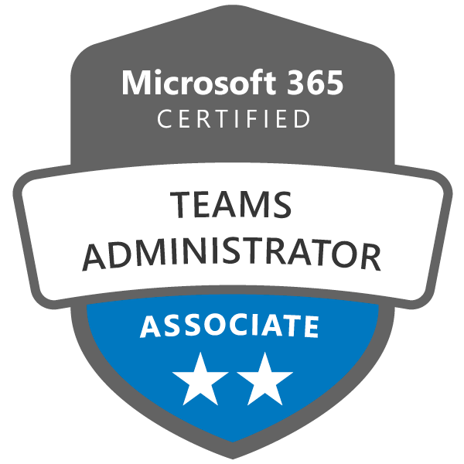

Certification Name: Teams Administrator Associate
Exam Paper: MS – 700, Managing Microsoft Teams
Completed By: Vikas Mishra, Mehul Chauhan, Virendra Vasava, Divyang Ramani
Certification Name: Azure Administrator Associate
Exam Paper: AZ – 103, Microsoft Azure Administrator
Completed By: Rahul Jadhav, Divyang Ramani

Slide 2


Certification Name: Network Security Associate
(The Threat Landscape)
Exam Paper: NSE 1
Completed By: Vrushank Raval, Jayal Naik, Rahul Jadhav
Certification Name: Network Security Associate
(Fortinet Security Fabric)
Exam Paper: NSE 2
Completed By: Vrushank Raval, Jayal Naik, Rahul Jadhav

